Slide 1
Ray: A Distributed Framework for Emerging AI Applications
Philipp Moritz, Robert Nishihara, Stephanie Wang, Alexey Tumanov,
Richard Liaw, Eric Liang, Melih Elibol, Zongheng Yang, William Paul,
Michael I. Jordan, and Ion Stoica, UC Berkeley
13th USENIX Symposium on Operating Systems Design
and Implementation (OSDI ’18).

Slide 2
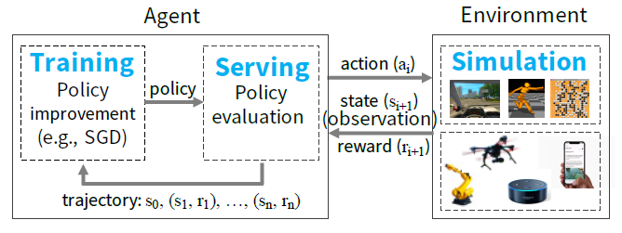
Introduction
Goal of RL applications – learn policy
Three main capabilities
1. simulation – to evaluate policy
2. distributed training – to improve policy
3. serving – to serve the policy
System Requirement
Fine-grained computations – Rendering actions in ms when interacting with environment and simulations
Heterogeneity and Resource Usage – GPUs for training and CPUs for simulations
Dynamic Execution – Results of simulations and actions can change future computations
Workloads
Lightweight and Stateless computations – simulation
Long running and stateful computations – training
Notes:
Fine-grained computations 같은 경우 action, state, reward 같이 작은 값들에 대해서 계산이 빠르게 되어야한다는 것
Dynamic execution 은 현재의 시뮬레이션과 액션이 미래의 연산에 영향을 줄 수 있어야 한다는 것입니다.

Slide 3
Introduction
Existing Framework
TensorFlow – not support simulation and serving
TensorFlow Serving and Clipper – support neither training nor simulation
Ray implements unified interface that can express
Tasks (task-parallel)
Load balance
Process large inputs (e.g., images, videos) and states
Recover from failure
Actors
Stateful computation – training
Expose shared mutable state to clients (e.g., parameter server)
Task Scheduler
Metadata Store
Fault Tolerance
Lineage-based: tasks and actors
Replication-based: metadata store
Notes:
TensorFlow Serving and Clipper - inference 에 초점이 맞춰져 있음

Slide 4

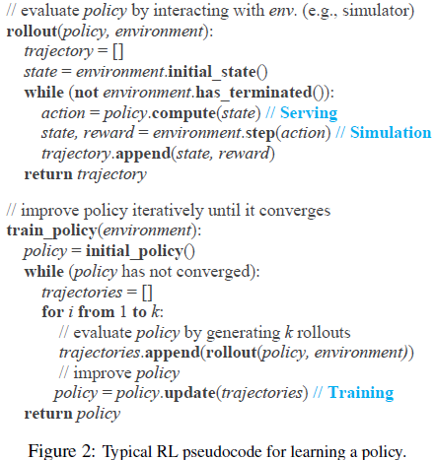
Motivation
Policy evaluation & Policy improvement
Training
Distributed SGD -> aggregation step or parameter server
Serving
Minimize latency
Maximum # of decisions per second
Simulation
Vary widely in complexity
(simple) A move in chess game
(complex) Simulate for a self-driving car
Training and Serving can be handled separately by different systems
All of these three workloads are tightly coupled in a single application
Notes:
그림에 대한 수도코드
Train_policy 부터 설명 - Trajectory [트리젝터리]
수도코드를 보면 알 수 있듯이, training, serving, simulation이 효율적으로 support 되어야 한다는 것을 볼 수 있다
각각의 단계에서 중요한 요소들 짚어보면,

Slide 5
Requirements
Fine-grained, heterogeneous computations
Duration of computations range from milliseconds to hours
Training often requires heterogeneous hardware (e.g., CPUs, GPUs, TPUs)
Flexible computation model
Stateless computations can be executed on any node in system
Easy to balance load and movement of computation
Good for fine-grained simulation, data processing
State computations
Parameter servers
Running 3rd-party simulators that don’t expose their states
Dynamic execution
Requires to RL applications because ..
the order where computations finish is not always known in advance
the results of a computation can determine future computations
Notes:
Miliseconds – 액션을 취하는 연산
시간 – 복잡한 정책을 트레이닝

Slide 6
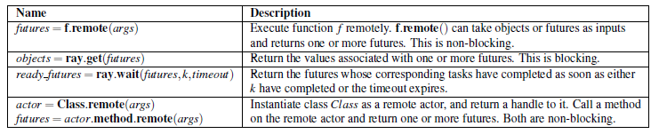
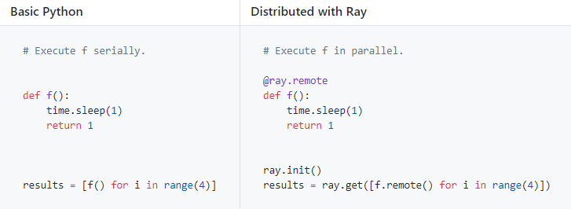

Programming Model
Ray implements a dynamic task graph computation model
Ray API
Tasks
The execution of a remote function on a stateless worker
Leverage load-aware scheduling fine-grained load balancing
Actors
Represents stateful computations and executes on state worker
Invokes remotely and executes serially
Can be used to
parameter server
Wrap 3rd-party simulators
Serialization and Deserialization fine-grained updates
Notes:
논블록 - 결과 요청 후 가만히 멈추지 않고 다른 일을 하는 것
블록 - 결과가 나올때 까지 멈춰서 기다리는 것
Ray API
Remote -> 함수를 다른 노드에서 remote하게 실행하게끔 해주는 것
Ray.wait -> k개의 이용가능한 결과만 기다림
Ray.get -> all result를 다 기다림
(애니메이션 예시)
Tasks 는 stateless 라서 체크포인트나 리커버리 할 필요가 없다

Slide 7
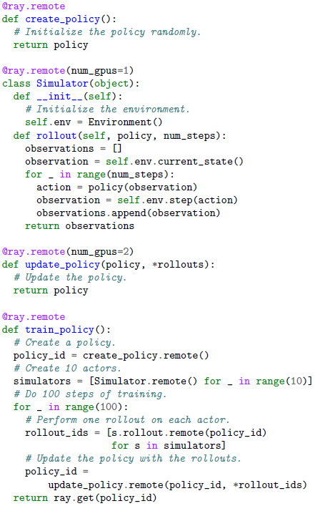
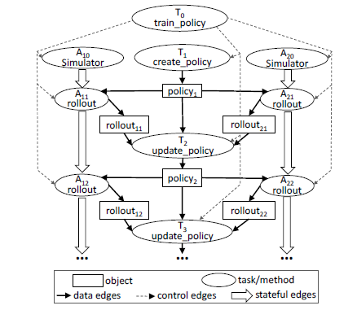
Computation Model
Chain
Execution of task graph is automatically triggered when input is available
Data edges
Dependencies between objects and tasks
Control edges
Dependencies from result from nested remote functions
Stateful edges
Dependencies actor method
Notes:
앞에 Motivation에서 설명한 정책을 학습하기 위한 수도 코드를 파이썬과 Ray를 이용해서
Train_policy() 부터 설명
Task graph에서 두 타입의 노드가 있음 – remote function 호출자 또는 task (동그라미) 그리고 data objects (네모)
Actor 와 task의 차이는 edge를 보면 알 수 있다. 앞에서 언급했듯 serial 하게 execute 되고, 이런 chain이 order를 기억하게 해 줌 (애니메이션)

Slide 8
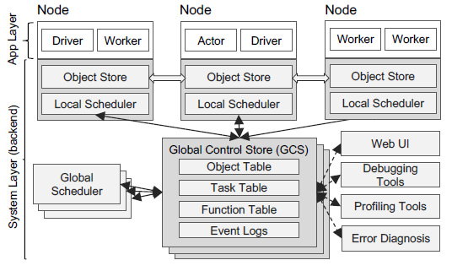
Architecture – Application Layer
Layer for implementing API
Driver
A process executing user program
Worker
A stateless process that executes tasks
When a remote function is declared, the function is automatically published to all workers
A worker executes tasks serially with no local state
Actor
A stateful process
Explicitly instantiated by a worker or driver
A actor executes serially and each method depends on the state resulting from the previous method execution
Implementation
72% in C++ and 28% in python
Notes:
User program – 앞에서 본 정책 학습과 같은 프로그램을 말함
Worker 안에 여러 개의 task가 들어가 있고, 이것들은 serial하게 실행 됨

Slide 9
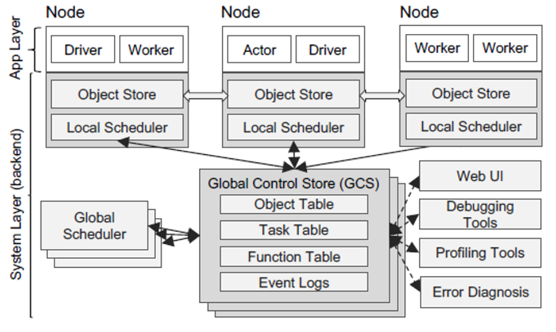
System Layer - Global Control Store (GCS)
Key-value store
Fault Tolerance
Decouple lineage storage from other system components
Low latency
Minimize overheads in task scheduling
Store object metadata in the GCS
Stateless
Enables every component to be stateless
Simplifies fault tolerance
Easy to scale the distributed object store
Implementation
Redis: key-value store per shard with single-key operations
Notes:
기존의 lineage storage 는 마스터라고 지칭하는 하나의 싱글 노드에서 관리하도록 되어 있어 coarse-grained parallelism 에 포커스
기존의 스케줄러는 centralized 되어 있지만, fine-grained task에 대해서 이러한 스케줄러는 오히려 오버헤드만 일어난다고 얘기하고 있습니다.
GCS에 필요한 정보들을 저장해 둠으로, 다른 시스템 컴포넌트들을 stateless로 만들어준다. (컴포넌트들이 GCS를 통해 state를 share)

Slide 10
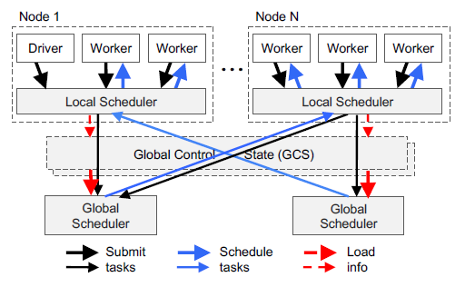
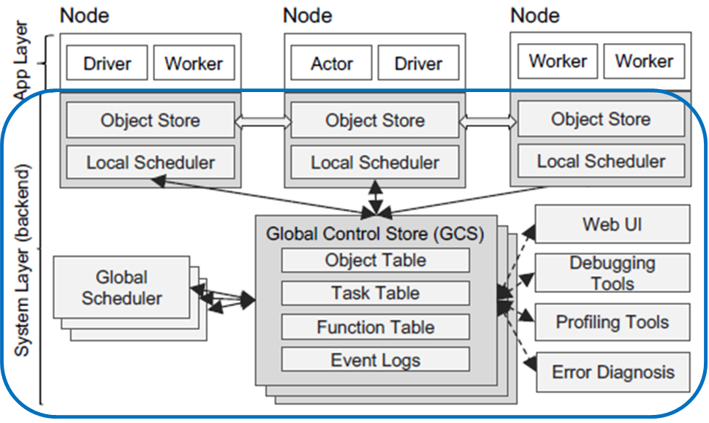
System Layer – Bottom-Up Distributed Scheduler
Centralized scheduler - locality latency
Distributed scheduler - locality latency
Two-level hierarchical scheduler
Tasks are submitted first to node’s local scheduler to avoid overloading
Local scheduler schedules tasks locally unless node is overloaded
Local task queue exceeds
Task requirement can’t satisfy (e.g., lacks GPU)
Global scheduler considers each node’s load and task’s constraints
Get task queue size at each node
Node resource availability via heartbeats
Location of task’s inputs and their sizes from GCS
If Global scheduler becomes bottleneck, instantiate more replicas scalability
Implementation
Event-driven, single-threaded process
Local scheduler maintains cached states
Notes:
로컬 스케줄러에서 먼저 tasks를 스케줄 한다 해서 bottom-up scheduler 라고 이름을 지었다고 합니다.
로컬 스케줄러 state – local object store에 있는 metadata 와 input을 기다리는 tasks들, worker에 보내기 위한 tasks

Slide 11
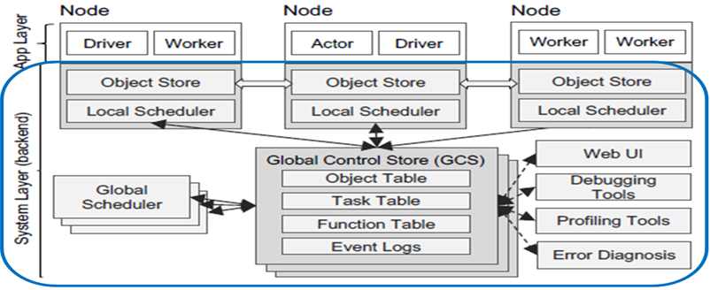
System Layer – In-Memory Distributed Object Store
Distributed storage system to store the inputs and outputs of every tasks
Minimize task latency
Implement via shared memory on each node
If a task’s inputs are not local, inputs are replicated to the local object store before execution
Task writes its outputs to the local object store
For simplicity, each object store fits on a single node
Implementation
To transfer large objects, TCP connections

Slide 12
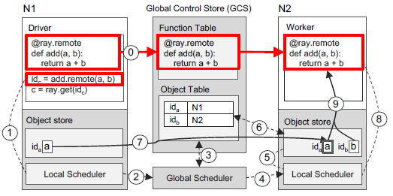
Simple Example – execute tasks remotely
0. remote function is automatically registered with the GCS and every worker
Submits add().remote(a, b) to Local Scheduler
Local Scheduler forwards it to Global Scheduler (if need)
Global Scheduler looks up the locations of arguments of remote function in the GCS
Global Scheduler decides to schedule it on Node 2 which stores argument b (Assume a doesn’t exist)
Local Scheduler checks whether the local object store contains arguments
Object store looks up a’s location in the GCS
GCS tells a is stored at Node 1, Node 2’s object store replicates it locally
Local Scheduler invokes add() at a local worker
Arguments a, b are accessed via shared memory
Notes:
Driver가 add.remote(a,b) 호출

Slide 13
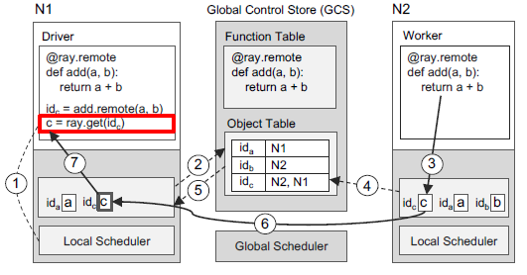
Simple Example – return the result of remote task
Driver checks local object store for the value c
Local Scheduler looks up GCS, there is no entry for c, c’s entry has been created (only N1)
At Node2, add() completes, store the result c in the local object store
Object store adds c’s entry to GCS (N2)
GCS triggers c’s entry to Node 1’s object store (idC)
Node 1 replicates c from Node 2
Return c to ray.get()
Notes:
Step2 에서 이전 슬라이드에서 object table 언급
Step3 에서 이전 슬라이드 8,9 번 언급

Slide 14
Evaluation
Experimental Setup
Run on Amazon Web Services
Use m4.16xlarge CPU instances and p3.16xlarge GPU instances
Microbenchmarks
Latency, Scalability, fault tolerance
Ray’s API overhead
Building Blocks
Evaluation of Training, Serving, Simulation

Slide 15
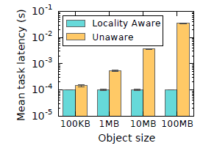
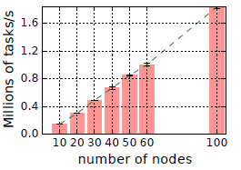
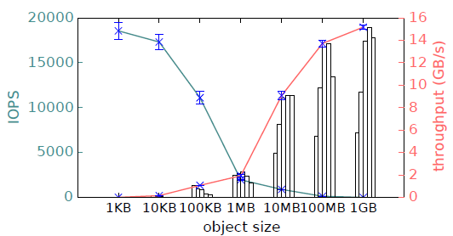
Evaluation - Microbenchmarks
Locality-aware task placement
Fine-grained load balancing
Locality-aware placement
End-to-End scalability
GCS and bottom-up distributed scheduler
Object store performance
IOPS(Input/Output Operations Per Second)
Write throughput
Overhead of Smaller object
Serialization
IPC between client and object store
Notes:
Actor – unaware
Scalability – 선형적으로 task throughput 이 증가 (parallel workload of empty task)
실제적인 workload는 object dependencies 때문에 그래프와 같이 나타나진 않는다
Small object – IOPS
Large object – Write throughput

Slide 16
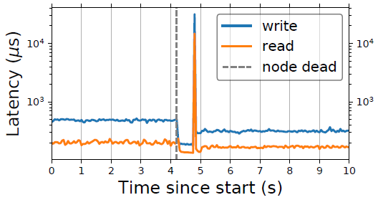
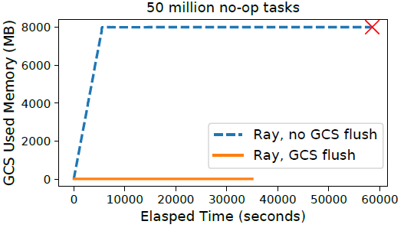
Evaluation - Microbenchmarks
GCS fault tolerance
A lightweight chain replication layer on top of Redis
Key – 25 bytes and Value – 512 bytes
reconfigurations caused a maximum client-observed delay of under 30ms
GCS flushing
periodically flush the contents of GCS to disk.
Notes:
GCS read and write latencies as viewed from a client submitting tasks.
4.2 초쯤 chain 하나가 죽음 -> reconfiguration (new chain member joins)
submit 50 million empty tasks sequentially and monitor GCS memory consumption
Grows linearly

Slide 17
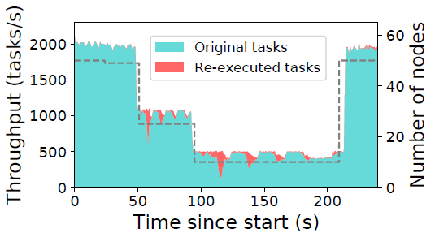
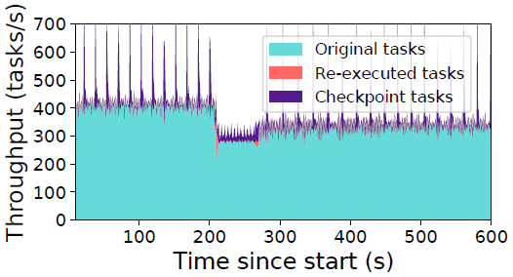
Evaluation - Microbenchmarks
Recovering from task failures
the local schedulers reconstruct previous results in the chain in order to continue execution
Overall per-node throughput remains stable
Recovering from actor failures
Leverages user-defined checkpoint functions to bound the reconstruction time for actors
checkpointing enables only 500 methods to be re-executed
Notes:
Ray reconstructs lost task dependencies as nodes are removed (dotted line), and recovers to original throughput when nodes are added back
-> 점선 언급

Slide 18
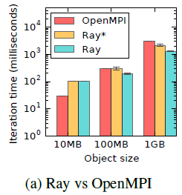
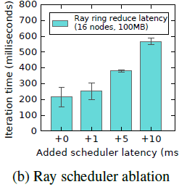
Evaluation - Microbenchmarks
Allreduce
A distributed communication
Ray completes allreduce across 16 nodes on 100MB in ~200ms and 1GB in ~1200ms (outperform OpenMPI)
Ray* restricts Ray to 1 thread for sending and 1 thread for receiving
OpenMPI sequentially sends and receives data on a single thread
Ray’s scheduler performance is critical to allreduce
Notes:
Smaller object에 대해서는 보완해야할 필요가 있다고 언급
artificial task execution delays and show that performance drops nearly 2 with just a few ms of extra latency

Slide 19
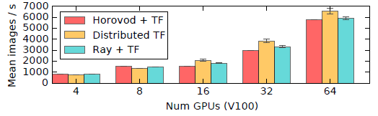


Evaluation – Building Blocks
Distributed Training
Model weights are synchronized via allreduce or parameter server (both implemented on top of the Ray API)
Performance Evaluation
ResNet-101 TensorFlow model
OpenMPI 3.0, TF 1.8, and NCCL2
Serving
focuses primarily on the embedded serving of models to simulators
low latency is critical for achieving high utilization
Performance Evaluation
both client and server processes are collocated on the same machine
Simulation
Due to the tight loop with training, it must be used as soon as they are available
Performance Evaluation
3n parallel simulation runs on n cores in 3 rounds
Ray achieves up to 1.8 x throughput
Notes:
Parameter serve의 최적화 기술을 쓴 Horovod 와 distributed 텐서플로우에 대해서 10% 내외의 퍼포먼스 차이
Serving
Clipper focus on serving predictions to external clients.
Simulation
Bulk synchronous 는 힘들다

Slide 20
Conclusions & Contributions
The first distributed framework that unifies training, simulation, and serving
Propose a system design principle where control state is stored in a shared metadata store and all other system components are stateless.
propose a bottom-up distributed scheduling strategy
The programming flexibility, high throughput, and low latencies simultaneously achieved by this architecture
Notes:
RL 어플리케이션을 위한
Scalability와 fault tolerance

